Slide 1

Internship Program: Soulvibe.Tech
“Facial Recognition-Based Cabin Access Verification System”
Batch Name:SVT/AIMLINT/2025/06/B08
Presented by: Bhuvaneswari Gummalavarapu

Slide 2

Introduction
.
Project Overview
Core Problem: Traditional access methods (keys, cards) can be vulnerable to loss, theft, or unauthorized sharing. There's a growing need for more secure, efficient, and auditable access control systems.
Project Goal: To develop an automated facial recognition system that provides secure and streamlined access verification for restricted areas, such as cabins, offices, or sensitive equipment rooms
Key Objectives:
Automated User Identification: Identify individuals in real-time using a webcam feed.
Secure Access Validation: Compare live facial data against a predefined database of authorized personnel.
Dynamic User Management: Enable administrators to easily add new authorized users to the system.
Comprehensive Activity Logging: Maintain a detailed record of all access attempts for auditing and security analysis.

Slide 3
Key Features & Functionality Deep Dive
Detailed Features:
Real-time Face Detection & Recognition:
Utilizes OpenCV to capture live video streams from a standard webcam.
Employs the face_recognition library to accurately detect face locations within each video frame.
Converts detected faces into unique 128-dimensional numerical "face encodings," representing distinct facial features.
Access Validation (Authentication):
Maintains a persistent database (authorized_users.csv) containing the names and face encodings of all authorized individuals.
Compares the live, detected face encoding against all stored encodings.
Calculates "face distance" to determine the likelihood of a match. If the distance is below a set threshold, access is "Granted"; otherwise, it's "Denied," and the individual is labeled "Unknown."
Integrated User Registration:
Admins can initiate the registration process directly from the main access control interface by pressing the 'A' key.
The system guides the admin through console prompts to input the new user's name.
A dedicated face capture sequence captures a clear image, extracts the face encoding, and saves it along with the user's name and a timestamp into the authorized_users.csv. A visual reference image is also stored in the train/ directory.

Slide 4
Key Features & Functionality Deep Dive
Comprehensive Access Logging:
Every single access attempt, whether successful ("Granted") or unsuccessful ("Denied"), is meticulously recorded.
Logs are timestamped and include the recognized name (or "Unknown") and the access status in access_log.csv, providing a clear audit trail.
Persistent Data Storage:
All critical system data, including authorized user profiles and detailed access logs, is stored persistently in structured CSV files (authorized_users.csv, access_log.csv).
The train/ directory stores corresponding images for visual verification of registered users.
Intuitive Visual Feedback:
The real-time webcam feed displays dynamic bounding boxes around detected faces.
The color of the bounding box and accompanying text messages provide instant feedback: green for "Access Granted" and red for "Access Denied" or "Unknown."

Slide 5
Detailed System Workflow
Conceptual Flow (Access Control):
System Initialization: Upon execution of access_control.py, the system initializes the webcam and loads all existing
authorized user data (names and face encodings) from authorized_users.csv into memory.
Continuous Frame Capture: The webcam continuously captures video frames.
Frame Pre-processing: Each captured frame is resized and converted to RGB format, optimizing it for face detection.
Face Detection: The face_recognition library rapidly scans the pre-processed frame to identify and locate all
faces present.
Face Encoding & Comparison: For each detected face, a unique 128-D face encoding is generated.
This encoding is then compared against the entire set of known authorized face encodings.
Decision & Logging:
If a strong match (low face distance) is found, the user's name is assigned, and "Access Granted" status is set.
If no match is found, the face is labeled "Unknown," and "Access Denied" status is set.
Immediately after the decision, the event (Name, Timestamp, Status) is appended to access_log.csv.
Visual Overlay: Bounding boxes (green for granted, red for denied) and status text are drawn directly onto the live
video frame.
Display & User Input: The annotated frame is displayed using cv2.imshow. The system simultaneously listens for
keyboard inputs ('Q' to quit, 'A' for registration).
Loop/Exit: The process loops back to frame capture, or exits if 'Q' is pressed.

Slide 6
Detailed System Workflow
Conceptual Flow (User Registration - Integrated 'A' Key):
Admin Initiates: An administrator presses 'A' during live access control.
Access Control Pause: The main webcam stream is temporarily released, and its display window is closed to free camera resources.
Name Input: The system prompts the admin via the console to enter the new user's name. Includes checks for duplicate names and prompts for overwrite confirmation or a new unique name.
Face Capture: A separate, temporary camera session activates (often without a visible window during capture to keep it clean) to capture the user's face.
Face Validation & Encoding: The captured image is analyzed to ensure exactly one face is detected. If valid, its 128-D encoding is generated.
Data Storage: The user's name, encoding, and timestamp are saved to authorized_users.csv, and a corresponding image is stored in train/.
Access Control Resume: The main webcam is re-initialized, its window reappears, and the authorized_users.csv database is reloaded to include the newly registered individual.

Slide 7
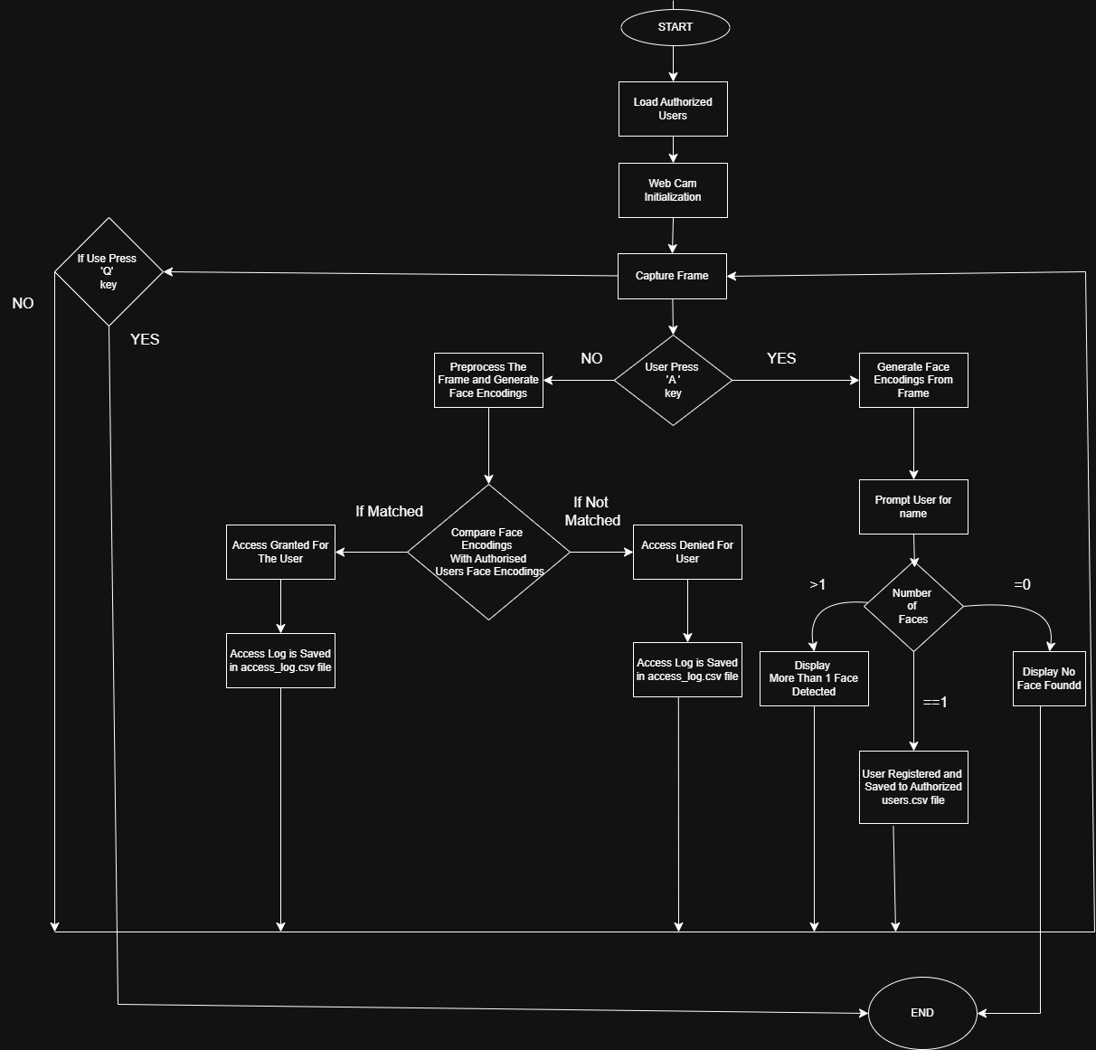
Flow Chart

Slide 8
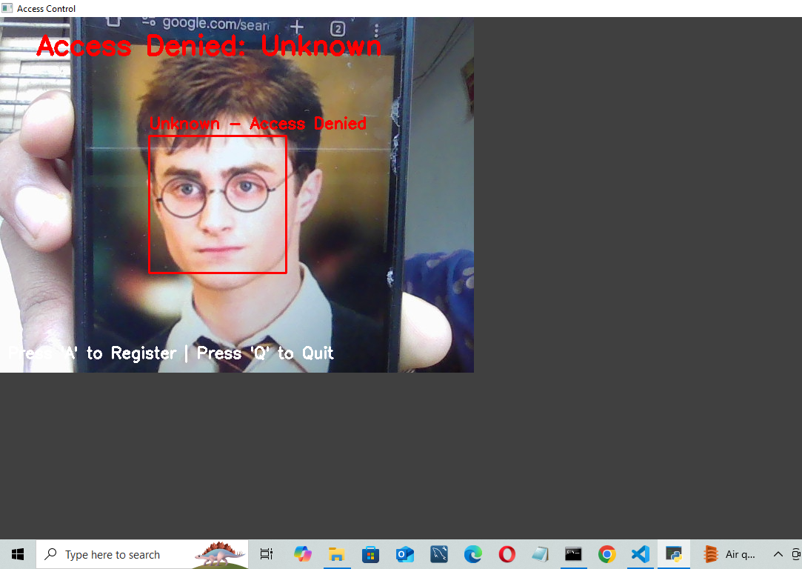
Add User Functionality
This screenshot shows the user registration stage where an admin starts the process by clicking on the 'A' key. The program requests the name of the new user, takes a clear face picture with the webcam, and saves the encoded information in the authorized_users.csv file. The picture is also saved in the train/ directory to be used for verification later.

Slide 9
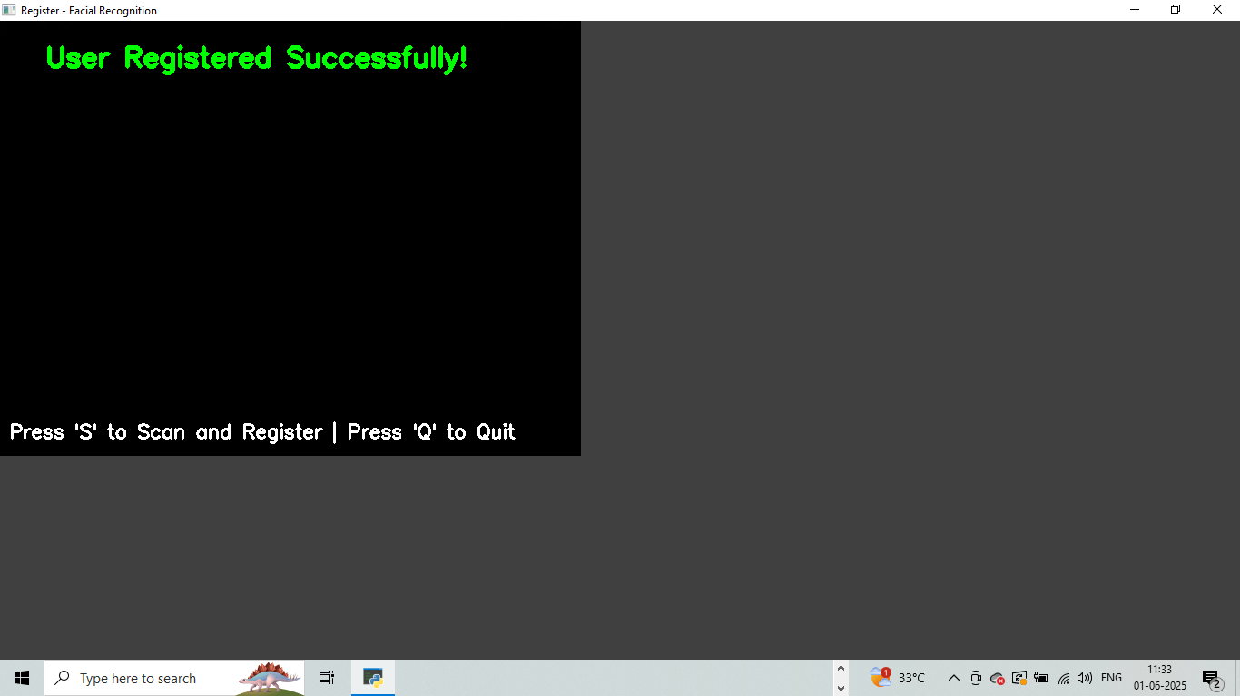
Registration Completed Message
Once the registration completes, a confirmation message is shown. It gives a confirmation that the new user's information along with facial encoding and timestamp has been saved, and the system is ready to resume live access monitoring with the modified user data.

Slide 10
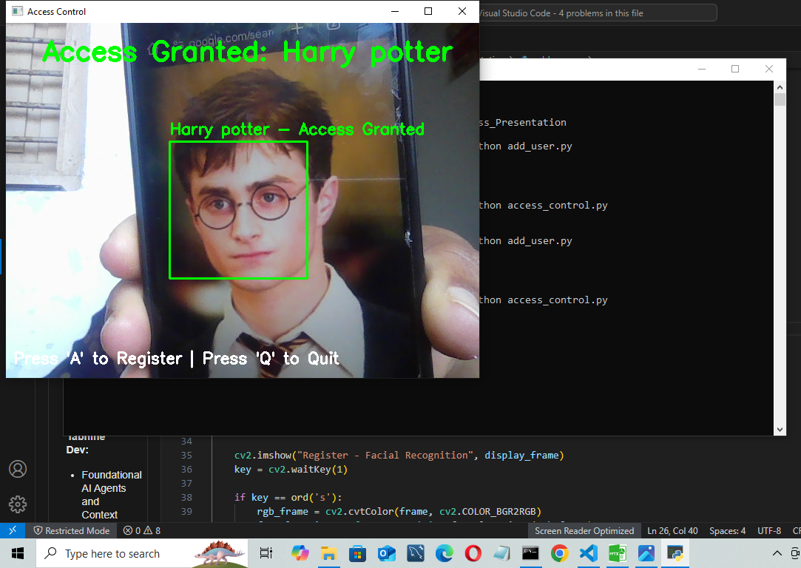
Access Control Functionality
This slide shows the live interface for access control. It pulls in a real-time webcam feed and automatically detects faces in the frame. Once a face is spotted, the system draws a bounding box around it—green if access is granted, red if it’s denied. It also adds a label on top of the box to show the result clearly. All of this happens on the fly using facial recognition.

Slide 11
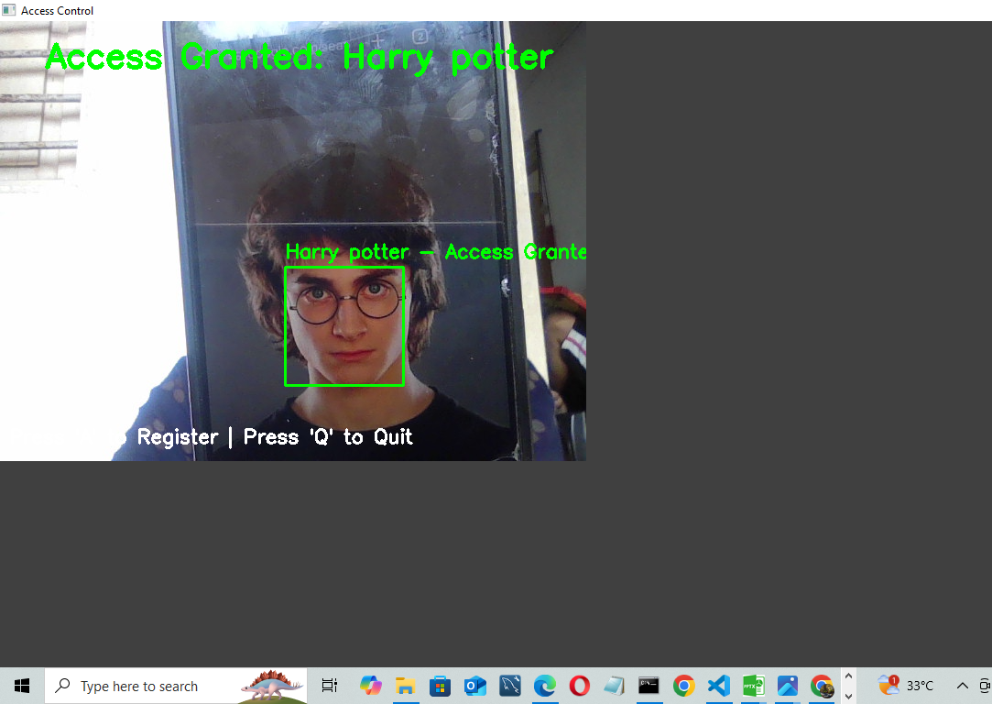
Access Granted
This slide displays the live access control interface in action. It streams real-time video from the webcam and detects faces automatically. Each detected face gets a bounding box—green for granted access, red for denied—along with a status label showing the decision. The whole process runs instantly, powered by facial recognition.

Slide 12
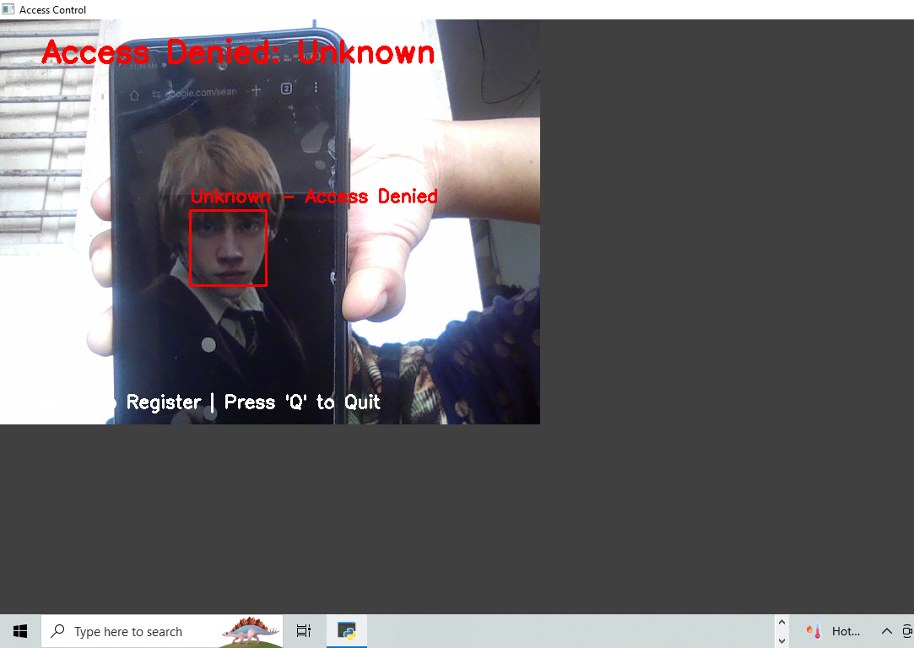
Access Denied
If the system doesn’t find a matching face in the database, it automatically denies access. The face is marked as “Unknown,” and you’ll see a red box around it labeled “Access Denied.” This real-time response helps flag any unauthorized attempts and keeps the system secure.

Slide 13
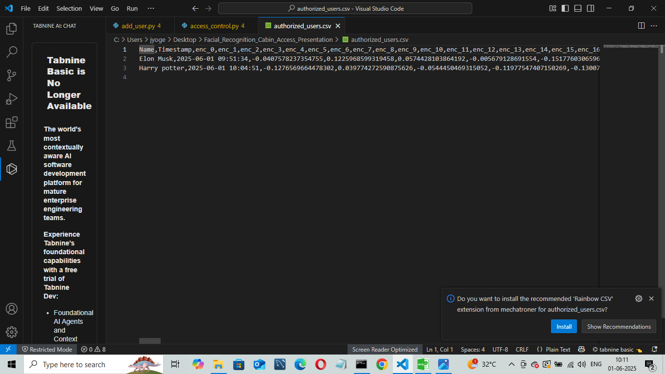
Authorized Users CSV File
This image shows how the authorized_users.csv file is organized. It keeps track of each registered user by storing their name, facial encoding, and the time they were added. This file helps the system remember who’s allowed in and makes it easy to look them up during future access checks.

Slide 14
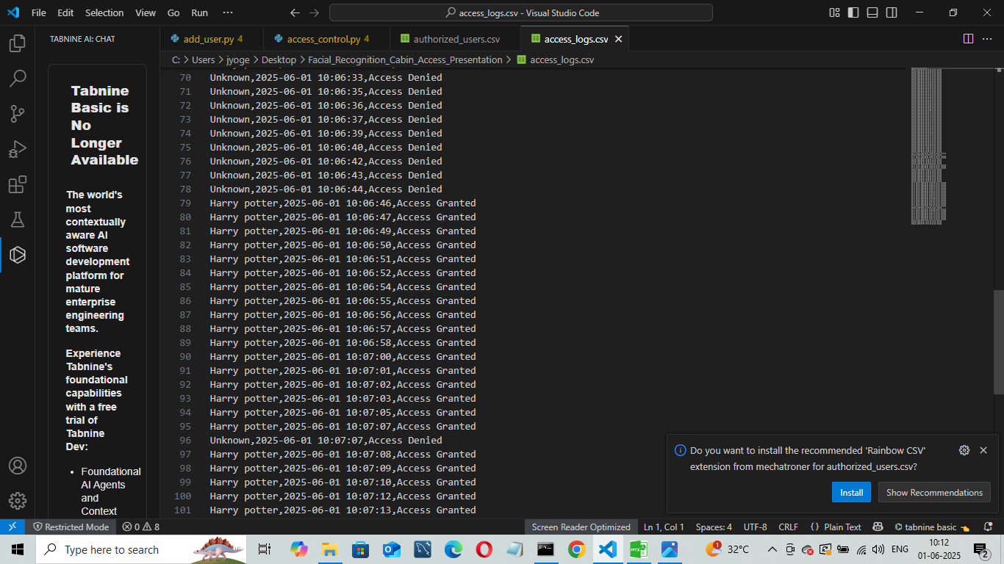
Access Log CSV File
This screenshot shows the access_log.csv file, where every access attempt gets recorded. For each entry, it logs the name (or "Unknown" if the face isn’t recognized), the timestamp, and whether access was granted or denied. It basically serves as a running history for security reviews and tracking who tried to get in.

Slide 15

Conclusion
Successfully developed a real-time facial recognition access control system.
Integrated webcam video feed, face recognition, user registration, and access logging.
Demonstrated strong use of Python libraries and error handling.
System is modular, extensible, and applicable to real-world use cases like lab entry, office cabins, and secure rooms.
Key Learnings:
Practical integration of computer vision libraries in Python.
How to encode, compare, and recognize human faces using deep learning embeddings.
Use of pandas and CSV for lightweight data storage.
Hands-on experience in building user-friendly, robust security applications

Slide 16
Thank You

